Slide 1




PCA & t-SNE
Visualize
Single-Cell RNA-seq datasets
Statistical analysis of big data
in systems immunology
Hadrien LORENZO, PhD student, SISTM team

Slide 2
Single-cell RNA-Seq Overview

Slide 3
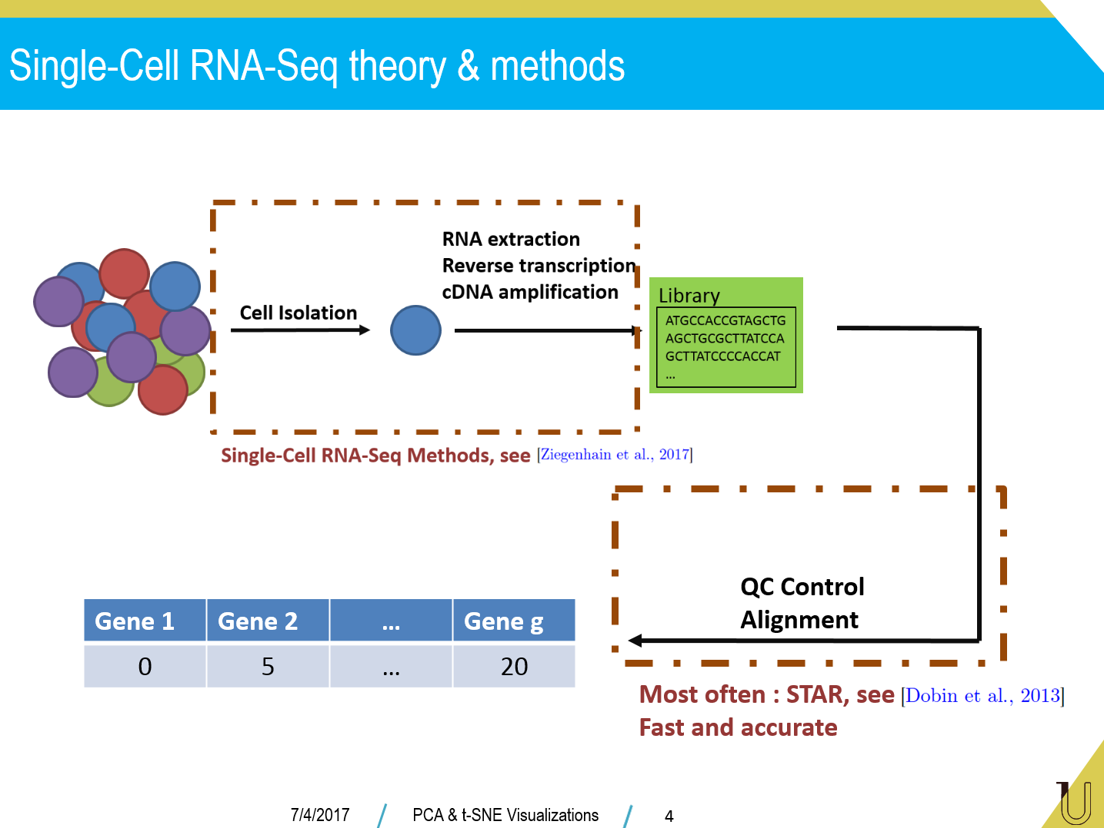
Single-Cell RNA-Seq theory & methods

Slide 4
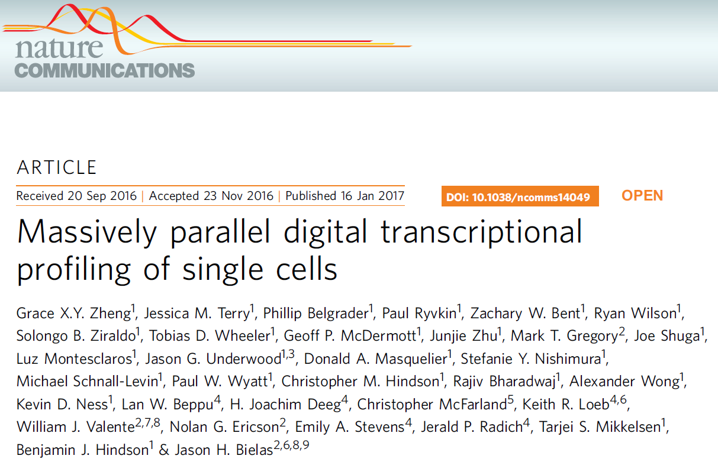
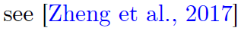
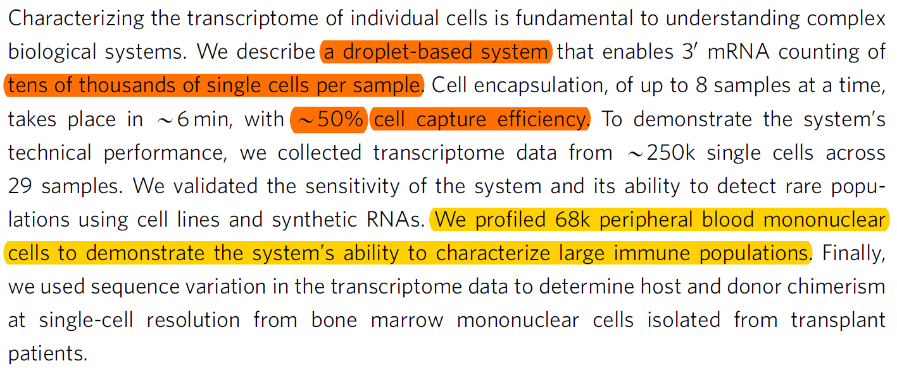
An handy dataset
Technical work, technology : 10x
PBMC Single-Cell RNA sequences :
7/4/2017
PCA & t-SNE Visualizations
5

Slide 5
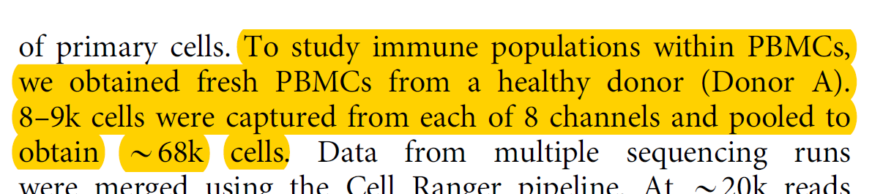
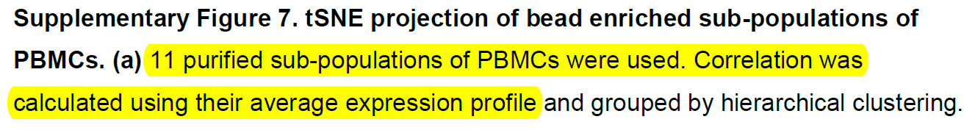
An handy dataset
Immune population from 1 donor :
… Cells labellised with purified subpopulation of PBMCs :
In this course :
4 populations
300 cells per population
CD 34 CD 14 CD 56 B cells
7/4/2017
PCA & t-SNE Visualizations
6

Slide 6
Single-cell RNA-Seq Dataset Structure

Slide 7
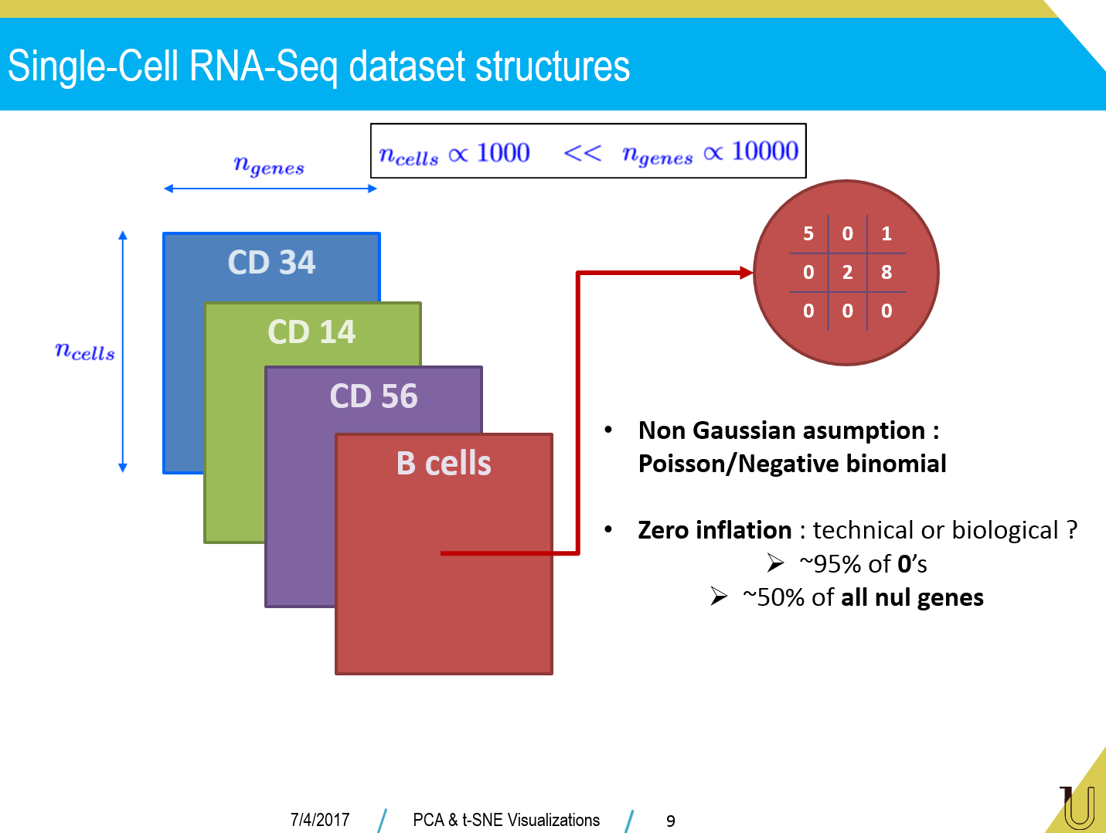

Slide 8
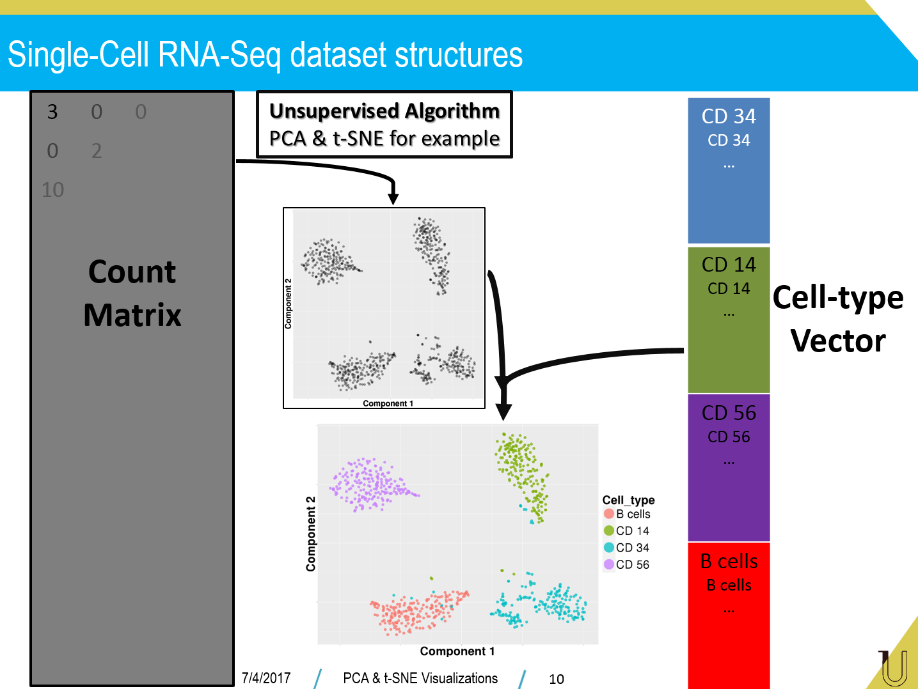

Slide 9
Single-cell RNA-Seq : Prepare datasets

Slide 10
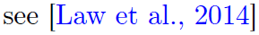
Prepare datasets
Think
PCA ;)
Remove batch effects :
Based on clinical design (if any…)
Not specific to
single Cell RNA Seq
data
Parametric : edgeR, DESeq2
Non parametric : Voom + Limma
Longitudinal & model Free: tcgsaseq
PCA & t-SNE
Gaussian models
Final transformation
log-CPM for example
7/4/2017
PCA & t-SNE Visualizations
12

Slide 11
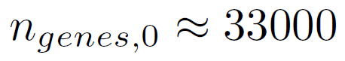
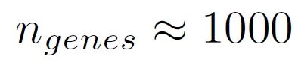
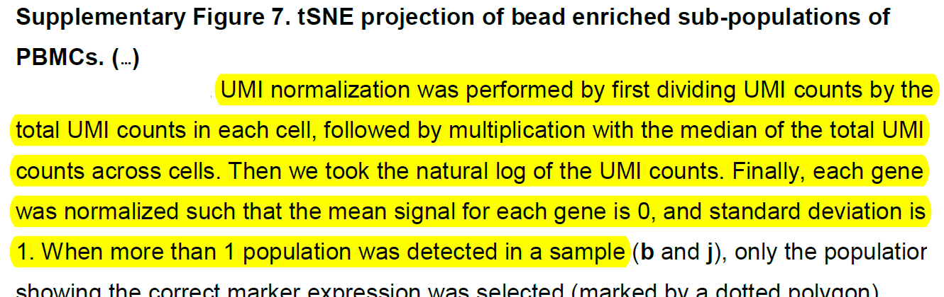
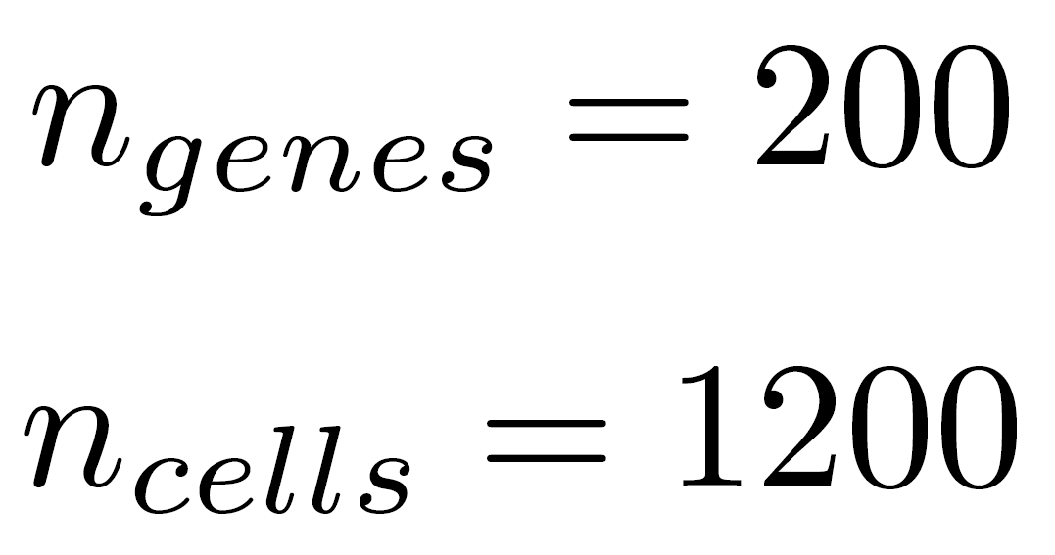
Prepare datasets
Remove 0 and almost 0 count genes
Genes with mean higher than a value
Specific to
single Cell RNA Seq
data
Initial
Count Matrix
Count Matrix
Remove 0 variance genes
In the paper :
7/4/2017
PCA & t-SNE Visualizations
13

Slide 12
Single-cell RNA-Seq : Visualization & Communication

Slide 13
Visualize Single-Cell RNA-Seq
Objectives
Appealing visualizations
Interpretable results
Biological challenges
Low number of replicates : a few participants
Samples sensible to lab conditions : long chain of manipulations
Mathematical constraints
Positive counts data with zero inflated values
High dimensionnal settings : thousands of genes
Unsupervised analysis : no cell labels
7/4/2017
PCA & t-SNE Visualizations
15

Slide 14
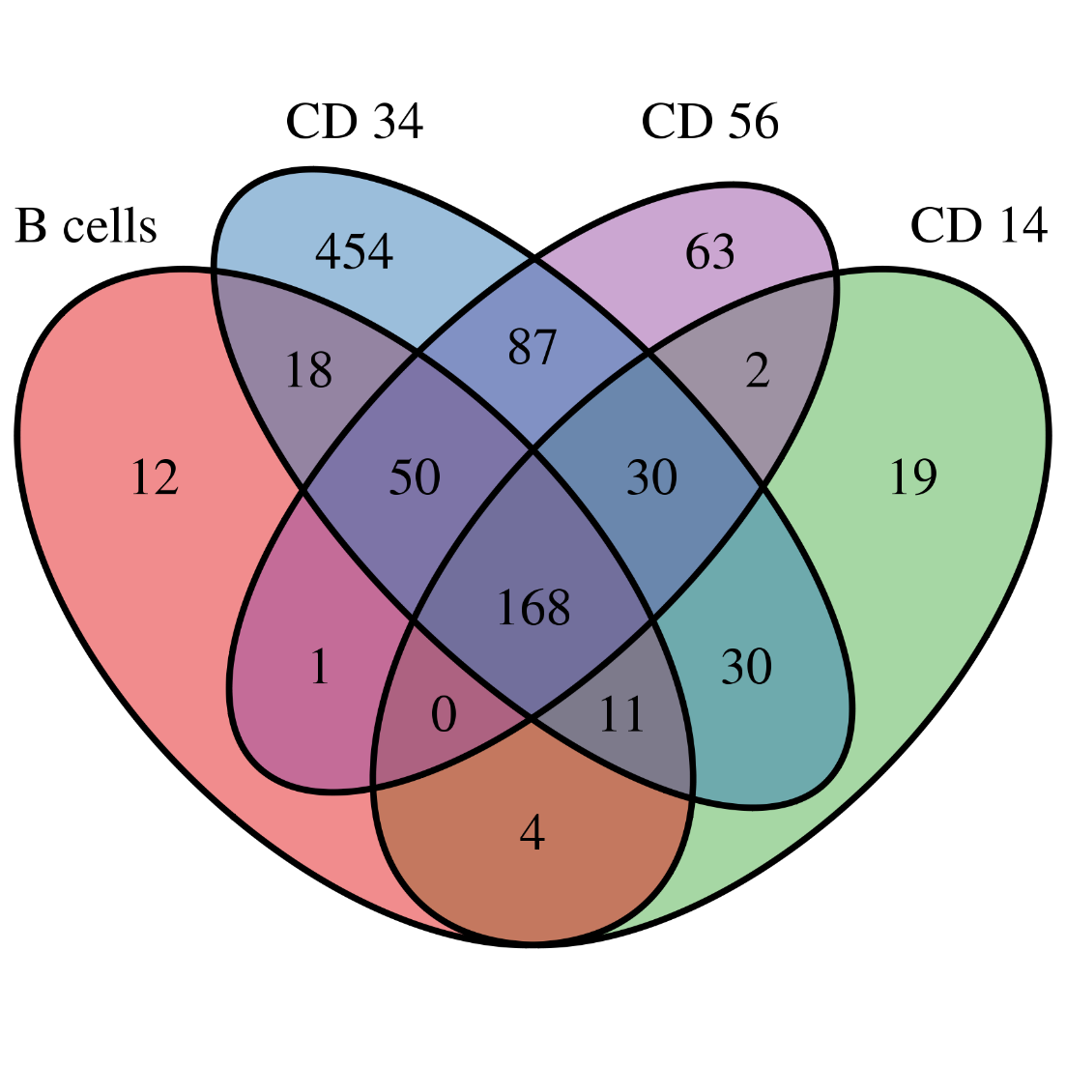
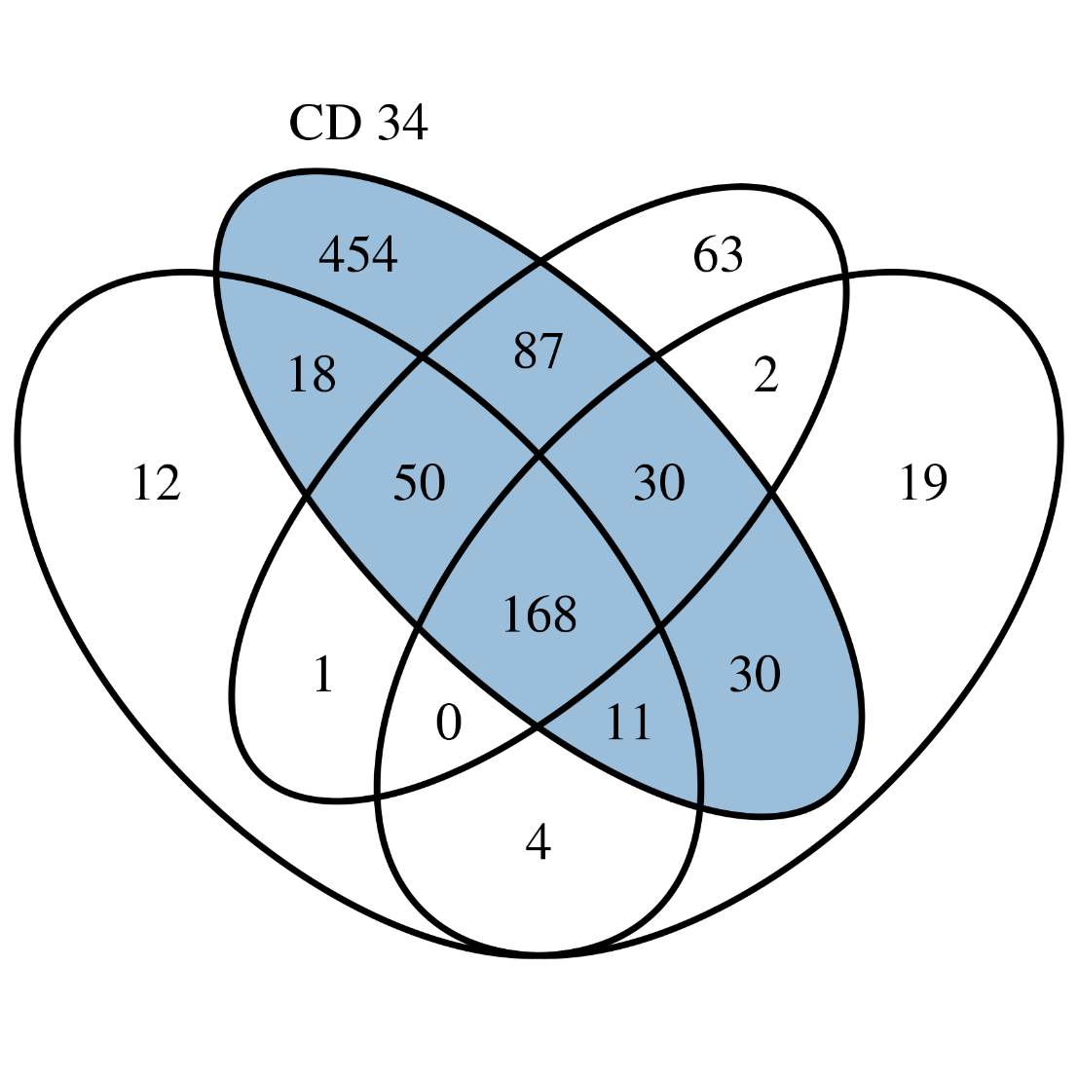
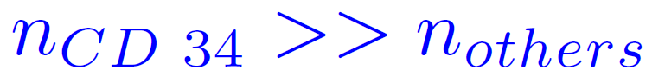
Ven diagramm as a first analysis tool
Explore dataset low counts
Per cell type :
Genes with count means higher than a value
Cell-Type | # Genes selected
B-cells | 264
CD 14 | 264
CD 34 | 848
CD 56 | 401
? Normal ?
Check deeper : Venn Diagram
Huge count!
? Multi modalities ?
7/4/2017
PCA & t-SNE Visualizations
16

Slide 15
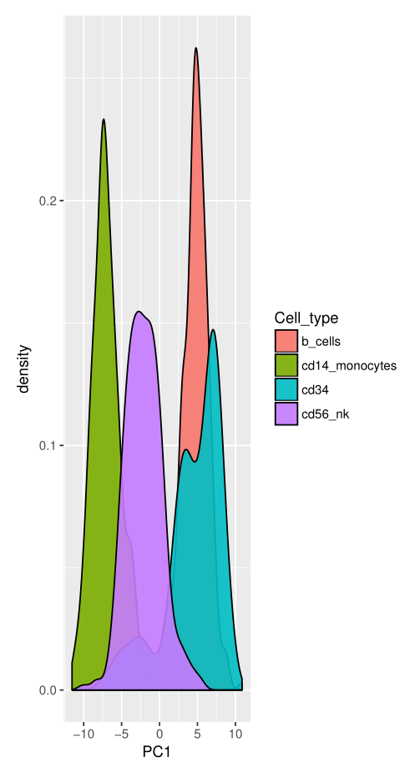
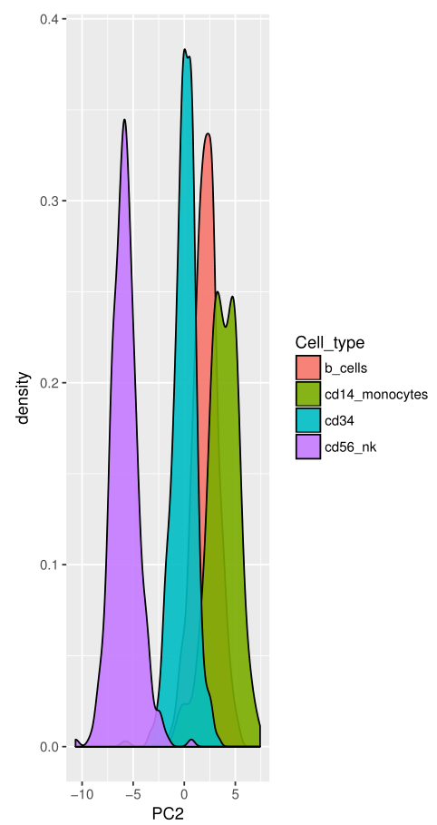
PCA for scRNA-Seq data visualization & interpretation
First Principal Component
Heterogeneity in CD 14 and CD 56
First principal component :
Heterogeneity in CD 14 and CD 56
Second Principal Component
Unimodality
Second principal component :
Variability in CD 56
Bi-modality
… where to stop ?
7/4/2017
PCA & t-SNE Visualizations
17

Slide 16
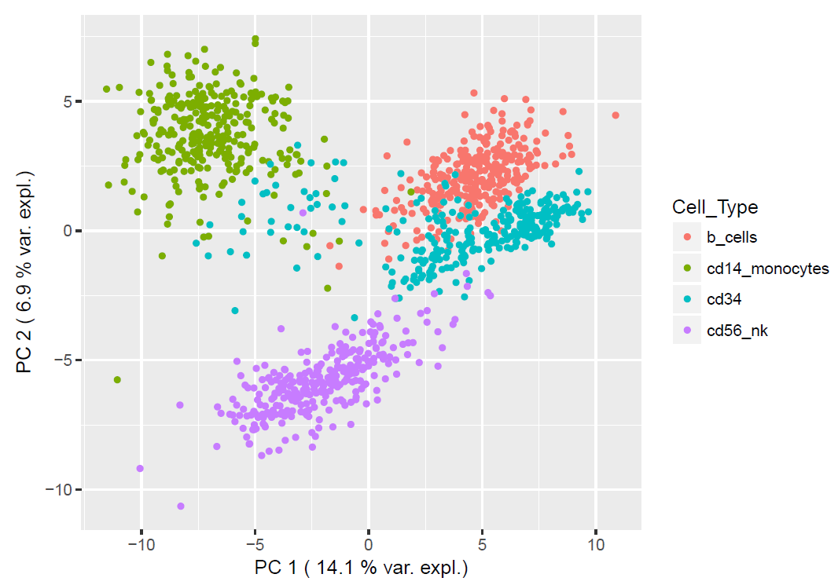
PCA for scRNA-Seq data visualization & interpretation
Two first axes interpretable
Independantly
Biological meaning
7/4/2017
PCA & t-SNE Visualizations
17

Slide 17
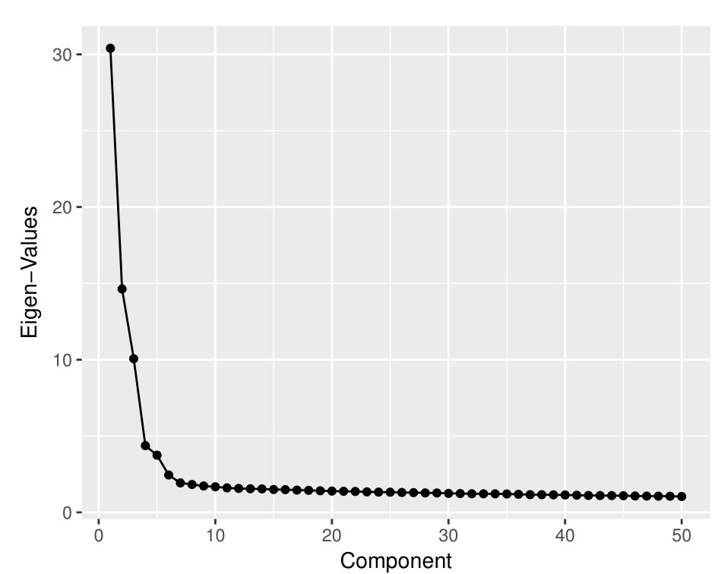
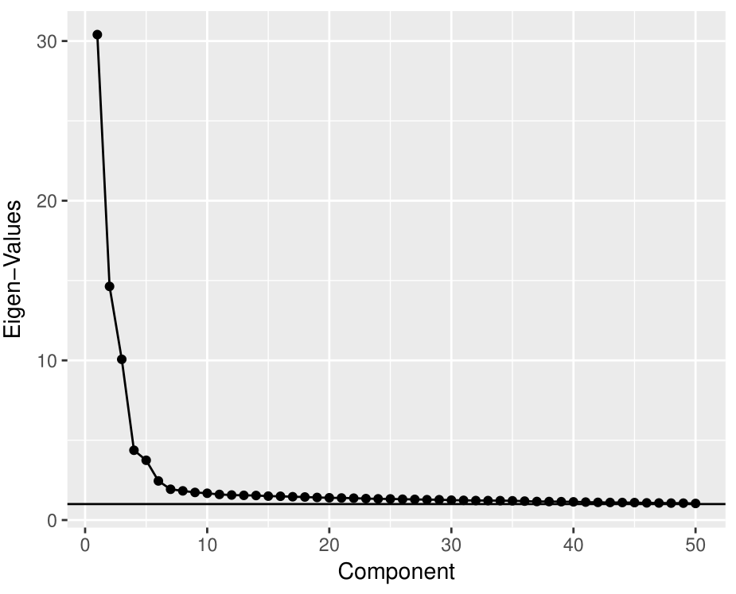
PCA for scRNA-Seq data : where to stop ?
2 usual criterions
Elbow criterion
Kaiser criterion
Mean(Eigen_Values)
Keep 6 components
Keep more than 50
components
7/4/2017
PCA & t-SNE Visualizations
18

Slide 18
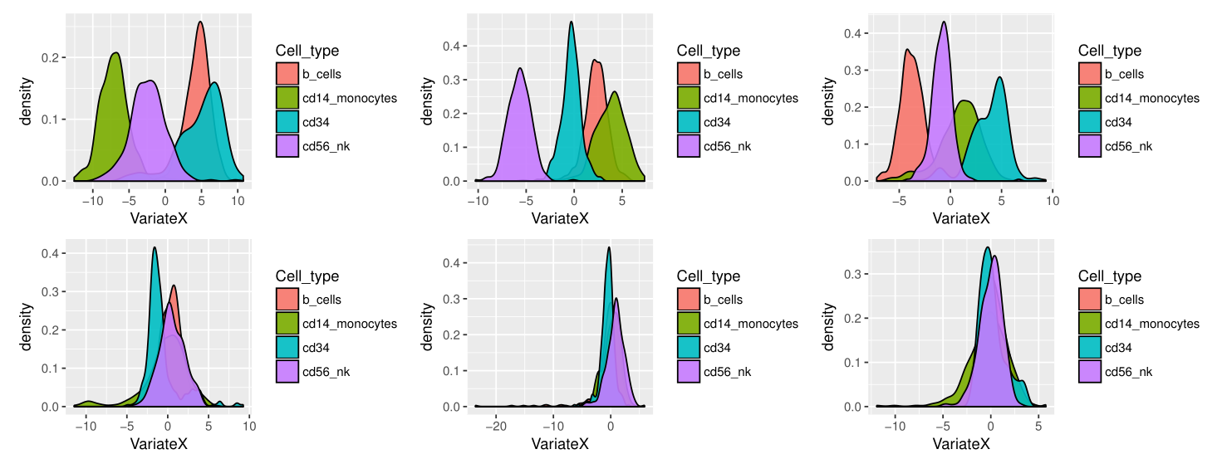
PCA for scRNA-Seq data : where to stop ?
How to visualize so many components ? (6)
Mean(Eigen_Values)
Keep more than 50
components
7/4/2017
PCA & t-SNE Visualizations
18

Slide 19
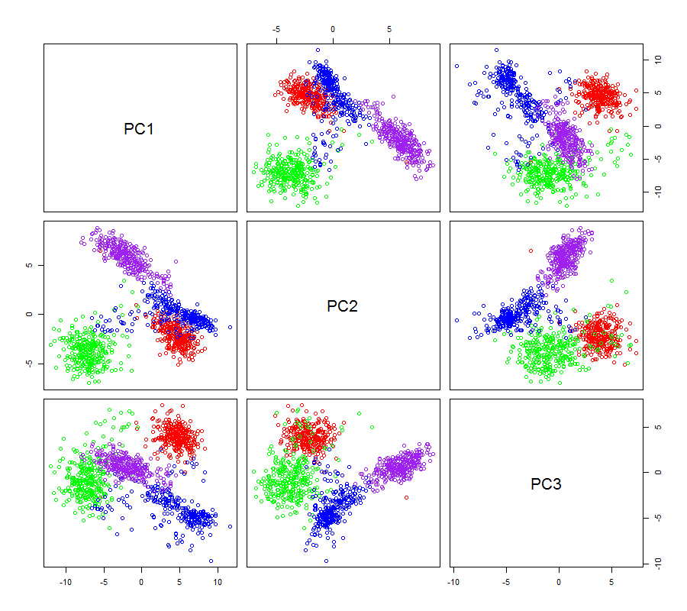
PCA for scRNA-Seq data : where to stop ?
3 components
Still hard to communicate!
Keep 3 first
components
Symmetric
→ Redundancy
→ Waste of place
PC 4,5,6
Hard to interpret
7/4/2017
PCA & t-SNE Visualizations
18

Slide 20
PCA for scRNA-Seq data : In a nutschell ?
PCA powers
Interpretability of each axis (independantly)
Stopping criterion
(mutual)
Maybe not for communication
Other way
Fix the number of dimensions where to project the data and then build those
2/3d
t-SNE
7/4/2017
PCA & t-SNE Visualizations
19

Slide 21
PCA for scRNA-Seq data : In a nutschell ?
PCA powers
Interpretability of each axis (independantly)
Stopping criterion
(mutual)
Maybe not for communication
Other way
Fix the number of dimensions where to project the data and then build those
2/3d
t-SNE
7/4/2017
PCA & t-SNE Visualizations
19

Slide 22
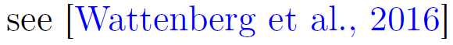
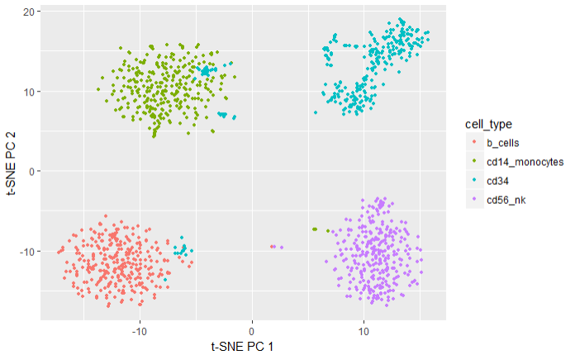
t-SNE : A visualization object for communication
Fix the number of dimensions : 2
Random initialization
Iterative process
Tune a few parameters :
PCA Pre-process : t-SNE faster!
Perplexity : Balance between local and global aspects.
7/4/2017
PCA & t-SNE Visualizations
20

Slide 23
t-SNE : A visualization object for communication
t-SNE permits :
Find clusters with non linear bounders
Interpret some cells as badly classified
Give an appealing 2-d visualization
t-SNE must not be interpreted too easily!
7/4/2017
PCA & t-SNE Visualizations
21

Slide 24
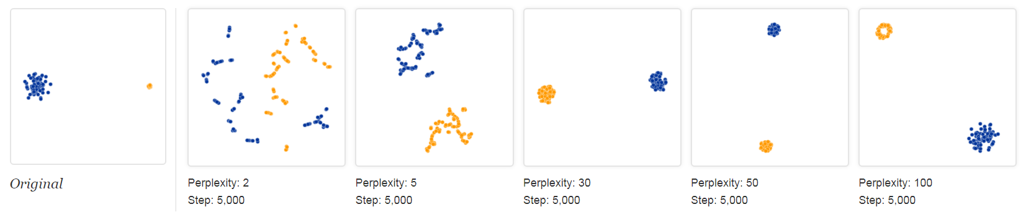
t-SNE : A visualization object for communication
t-SNE cluster sizes mean nothing!
7/4/2017
PCA & t-SNE Visualizations
22

Slide 25
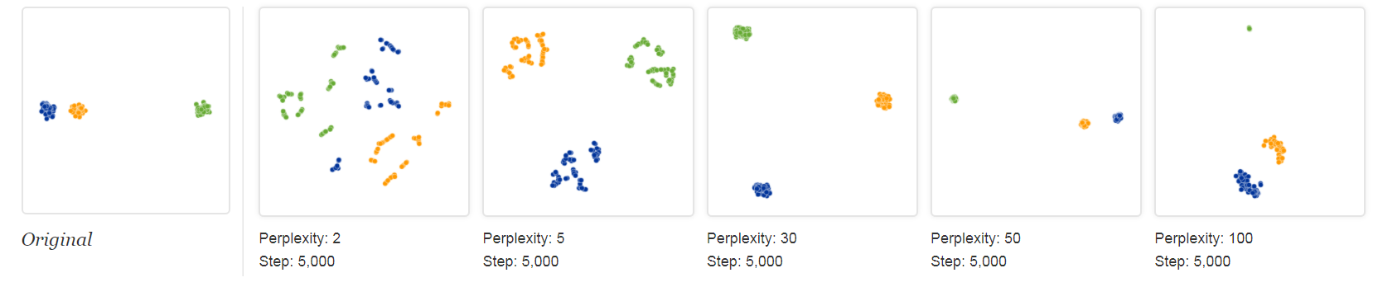
t-SNE : A visualization object for communication
t-SNE between cluster distances
mean nothing!
7/4/2017
PCA & t-SNE Visualizations
23

Slide 26
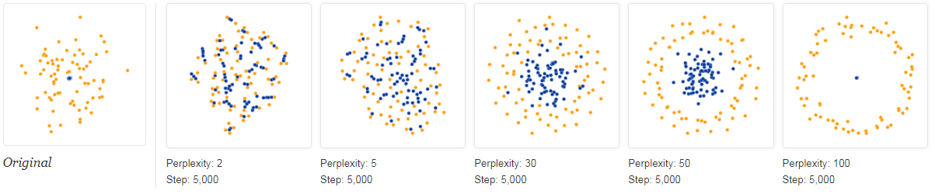
t-SNE : A visualization object for communication
t-SNE shapes may be just fantasy!
… mainly due to previous problems
7/4/2017
PCA & t-SNE Visualizations
24

Slide 27
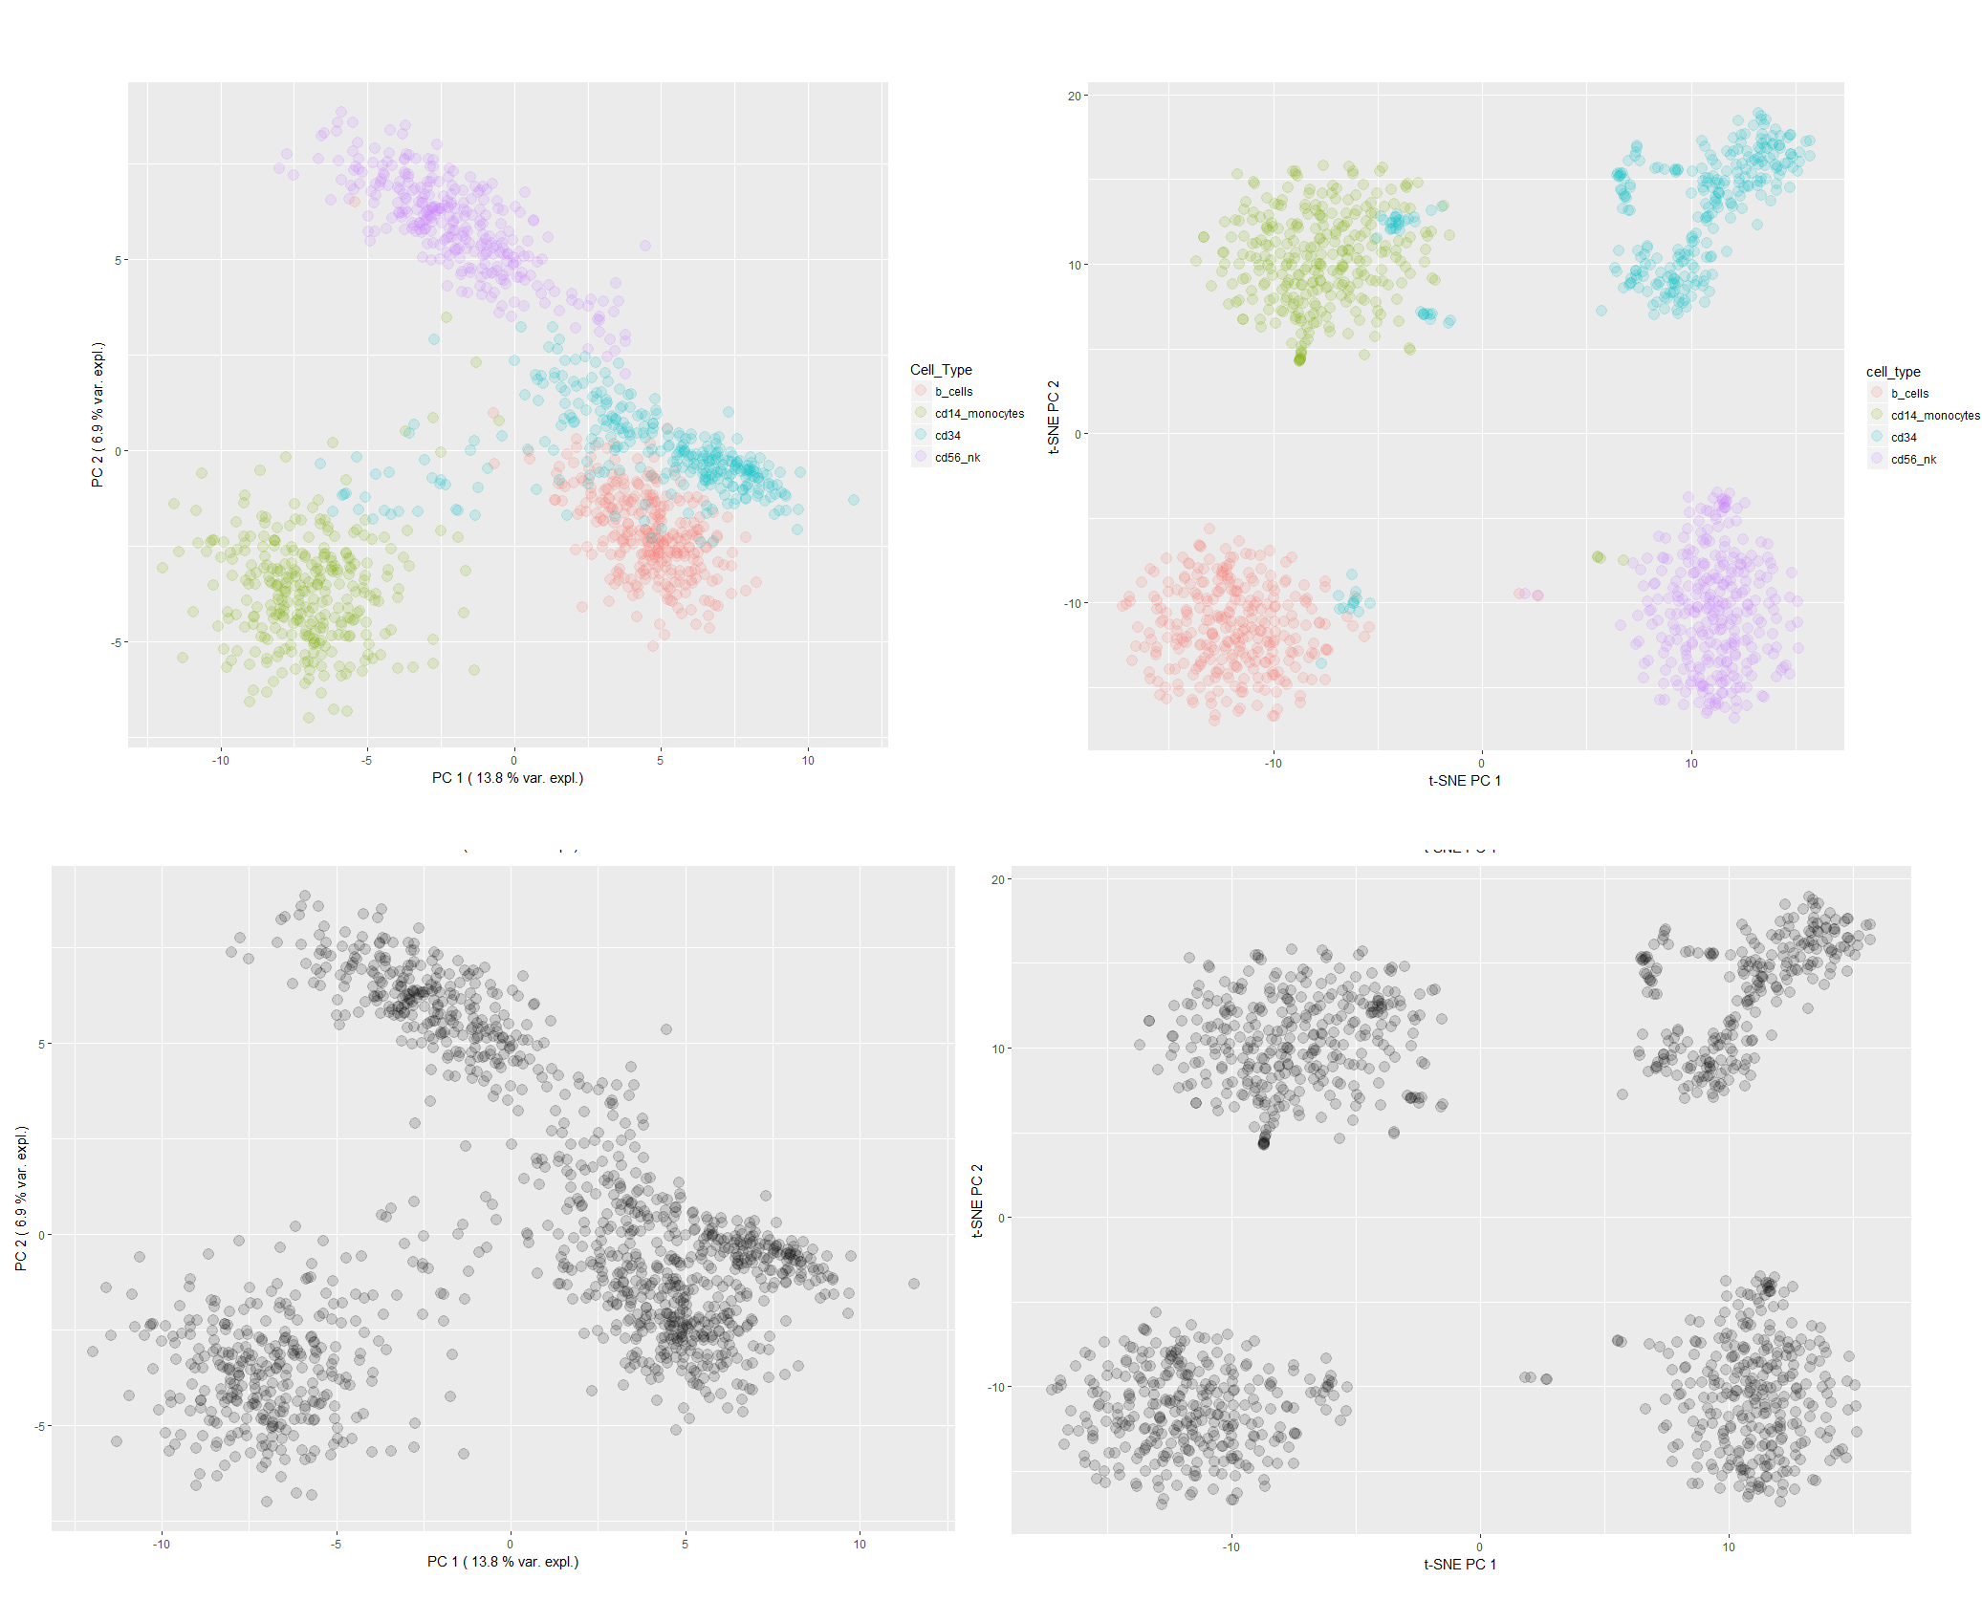
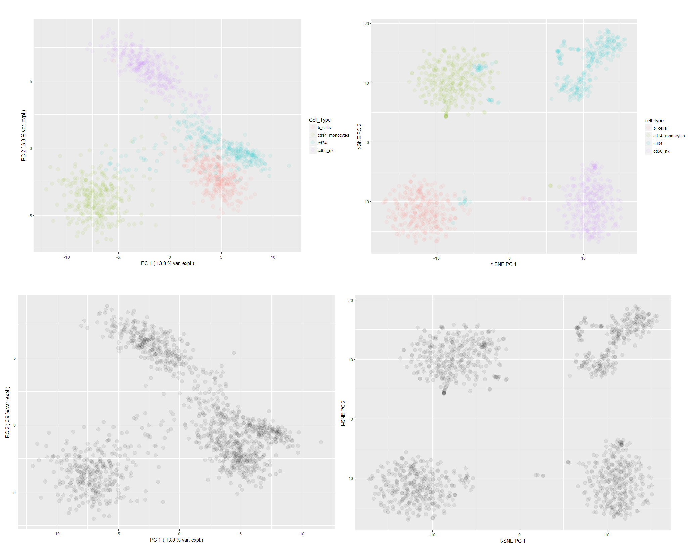
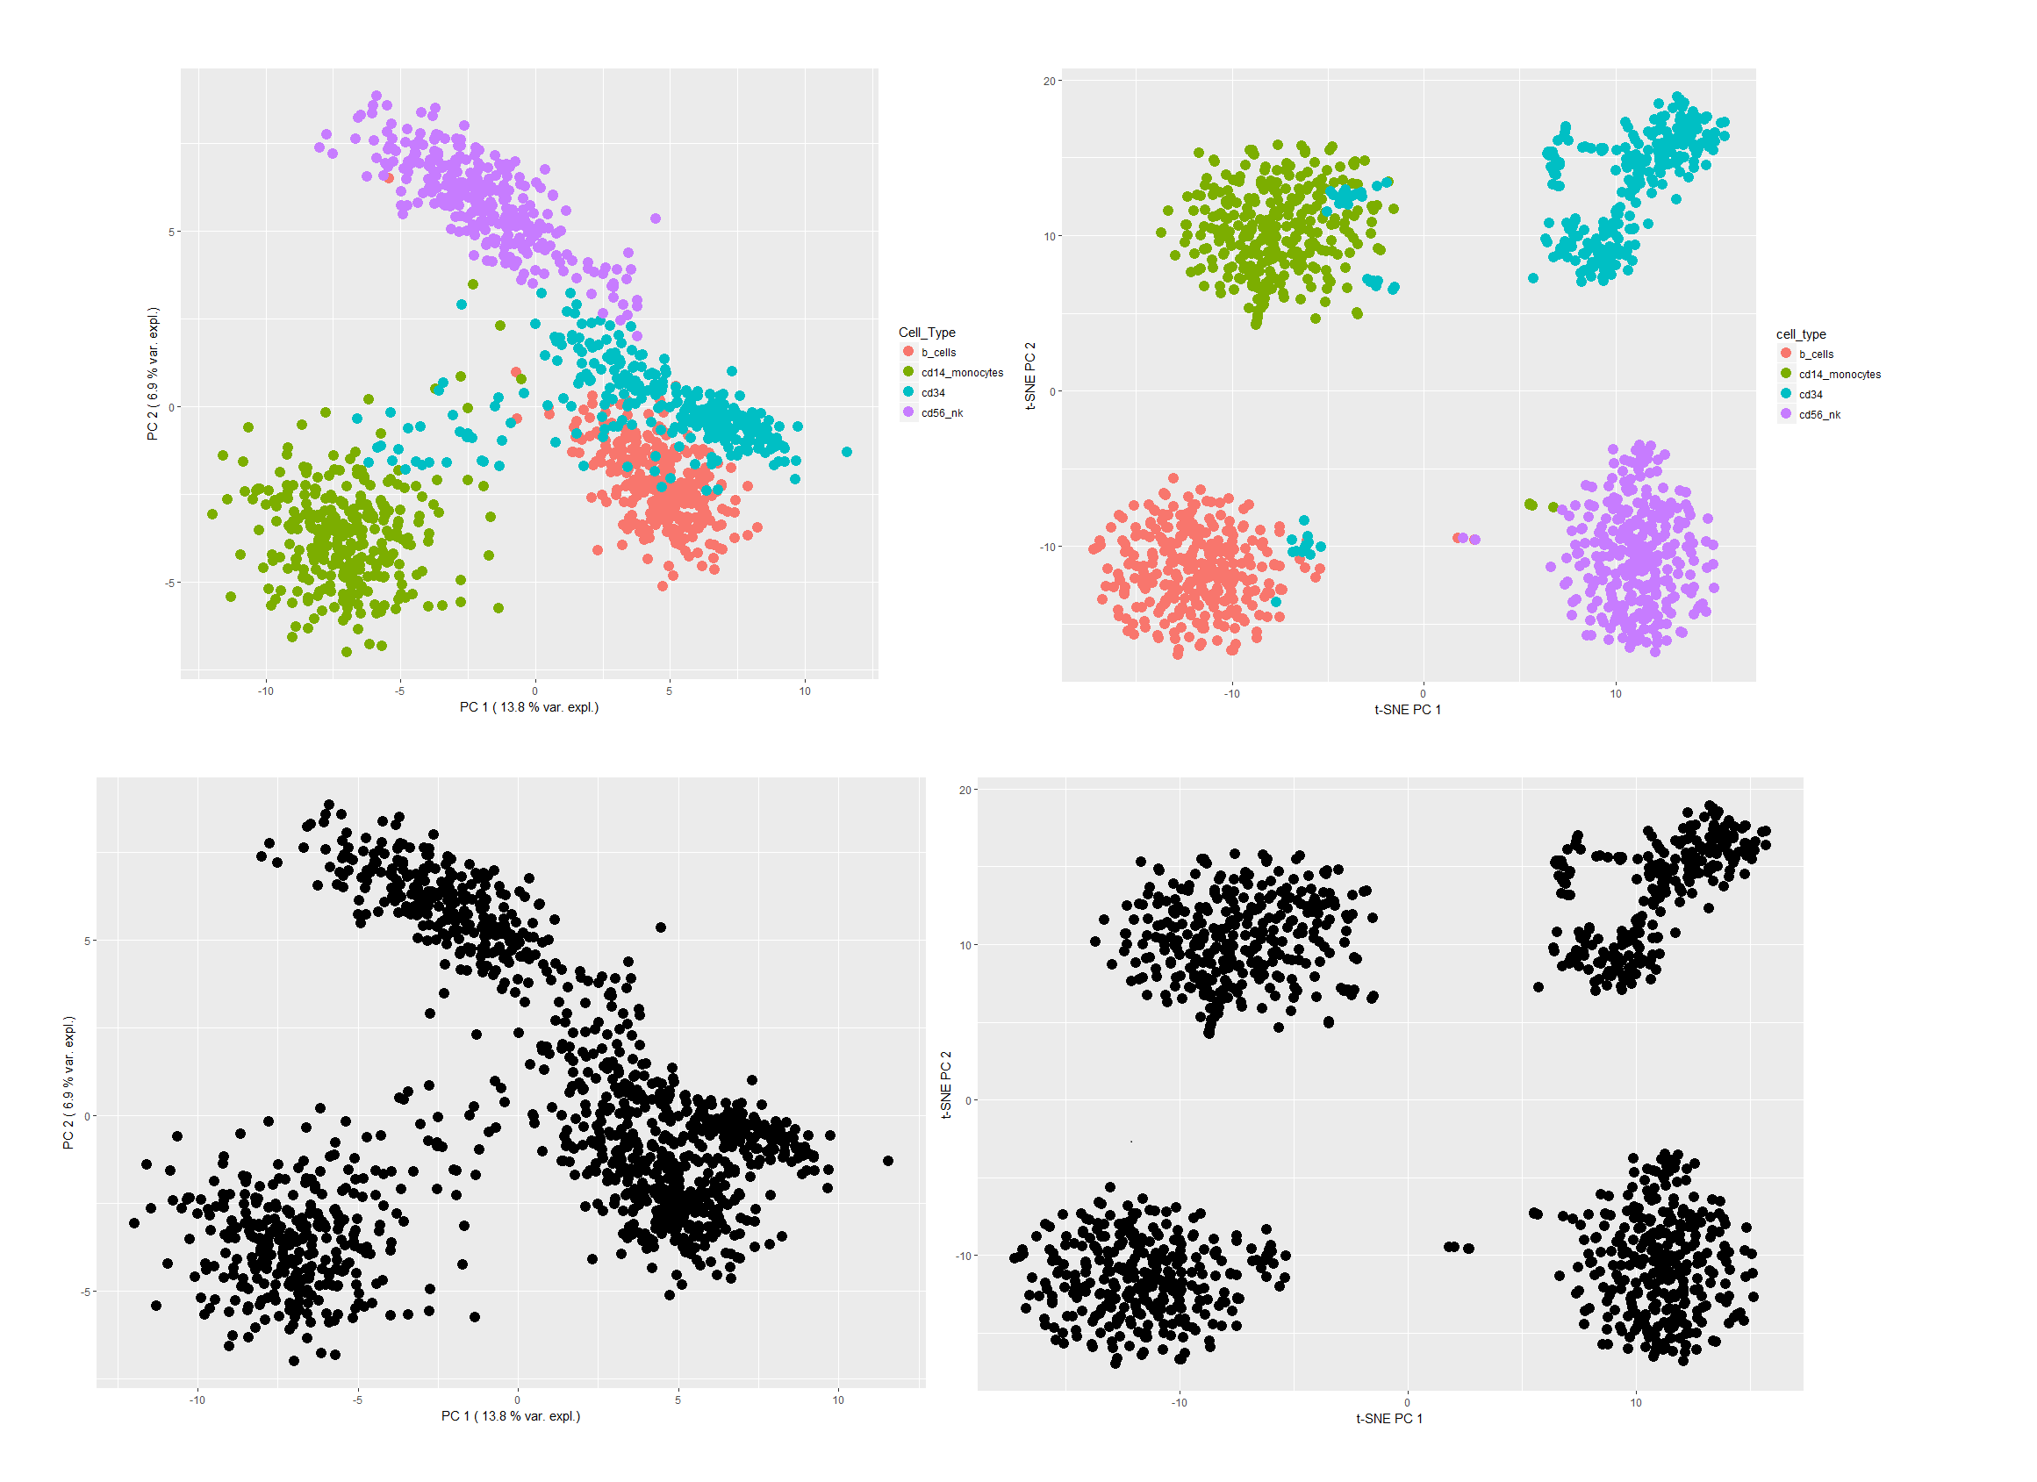
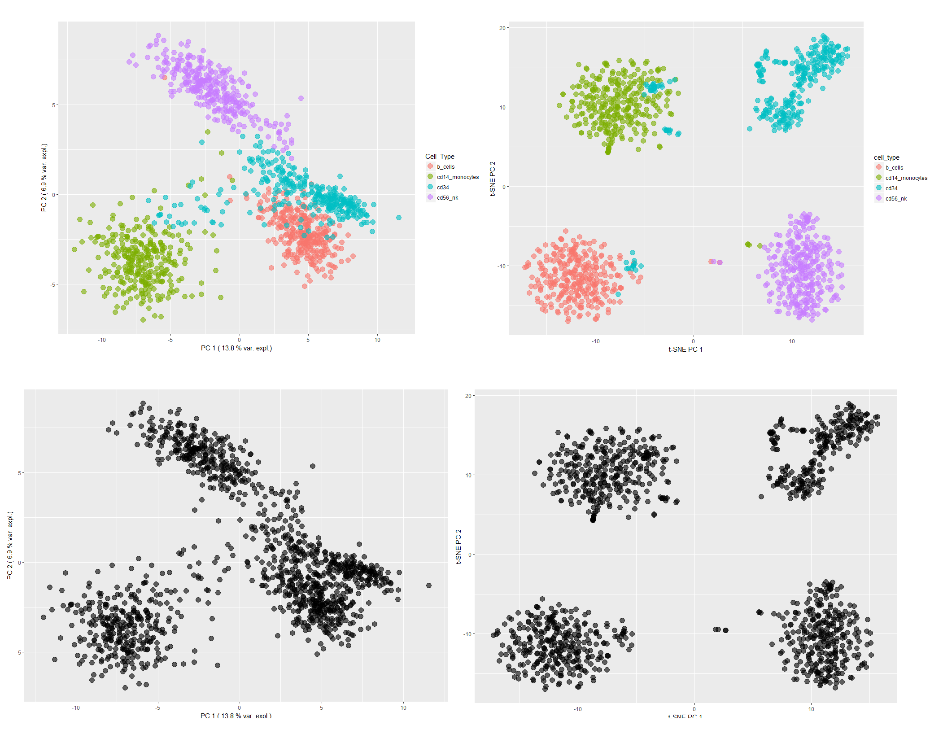
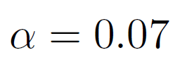
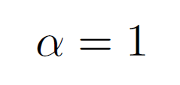
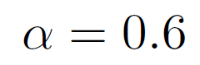
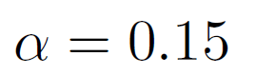
t-SNE : Not conserving the distances : a matter of transparency!
Transparency parameter :
Crowding problem
7/4/2017
PCA & t-SNE Visualizations
25

Slide 28
Conclusion

Slide 29
Conclusion
Two methods of representation :
PCA :
Interpretable from A to Z
Not strong enough for too complex datasets
Difficult for communication
t-SNE :
Flexible : fill 2 dimensions
Strong to non linear relashionships
Relative distances/positions not interpretable
Crowding effect not solved
Watch out naive conclusions !
Thank you!
7/4/2017
PCA & t-SNE Visualizations
27

Slide 30
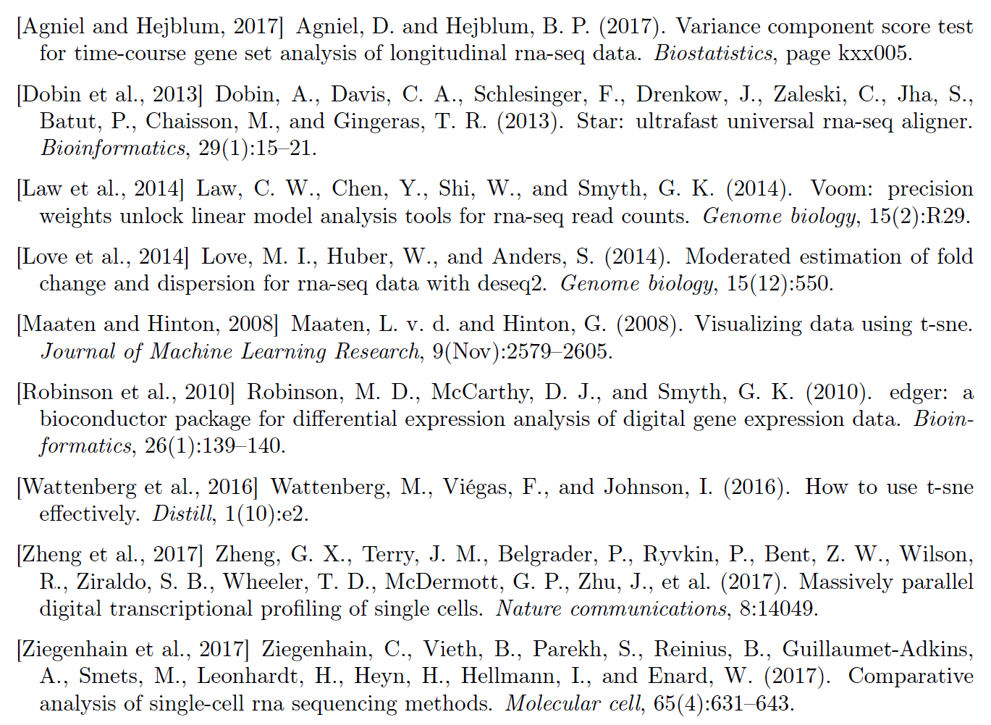
References
7/4/2017
PCA & t-SNE Visualizations
28

